Slide 1

Car Price Prediction
https://github.com/prapons01/UCB_AIML/blob/main/prompt_II.ipynb
Raju Ponniah
prapons@hotmail.com

Slide 2
Business Understanding
Used car market is very competitive
The car price determines profitability of the business along with how the inventory is managed (meaning the type of the cars to buy and sell)
The constraint to predict the price is due to limited data
Sometimes the car price is dictated by the local market conditions meaning the price in Irvine, CA will be higher than the price in South Bend, Indiana. This introduces an element of risk to the price prediction. To avoid this, we might have to use the regional dataset in that case as mentioned above we have limited data. The dealer should understand this risk and make a business decision accordingly.

Slide 3
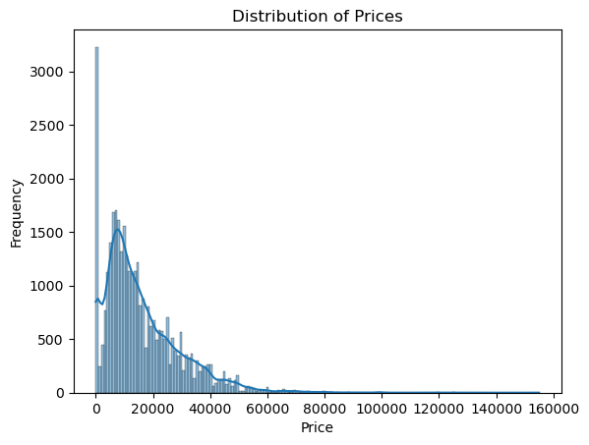
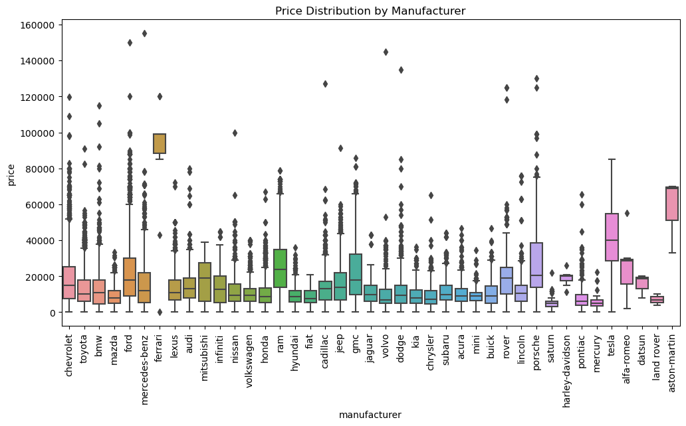
Data Understanding
Normally distributed ;
There are few cars priced very high, this could be due to wrong data (outliers)
Reasonable number of characters are in the dataset (like manufacturer, cylinders, transmission etc.…)

Slide 4
Data Preparation
Drop NAN records
Drop duplicates
Remove outliers
Calculate the age
Identify characteristics that needs to be given importance based upon the information (ordinality…ex: manufacturer) Vs characteristics that is more of yes or no type information (Fuel – Hybrid, Gas, Electric etc.…)
Determine the characters that are not going to be used like VIN number

Slide 5
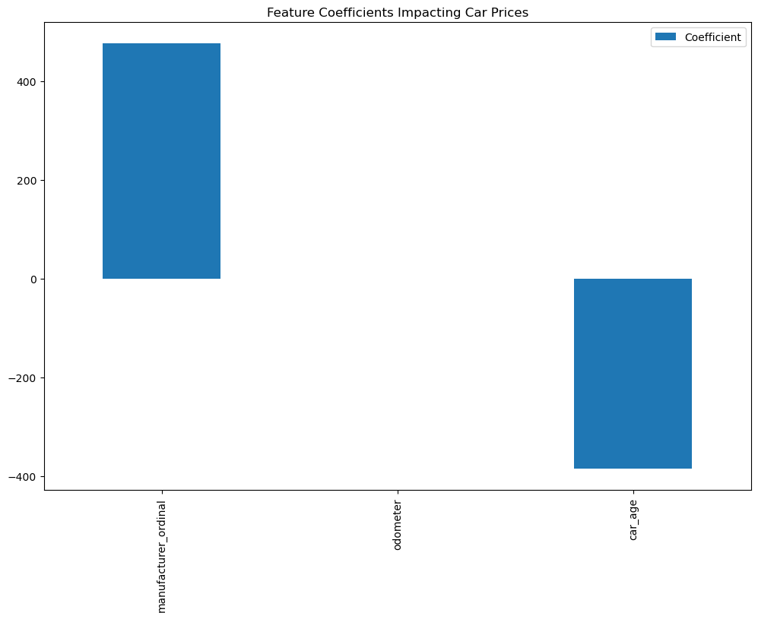
Model 1
The model is a very simple one
Based upon the manufacturer, odometer and age
The manufacturer average price is used for ranking the manufacturer to determine the price of the car
Age have negative correlation to the price of the car
Odometer has limited influence according to the model. This could be due to limited data
Higher positive Influence Factor results in higher price
Influence Factor on price
Manufacturer 476.11
Car age -385.58
Odometer -0.02

Slide 6
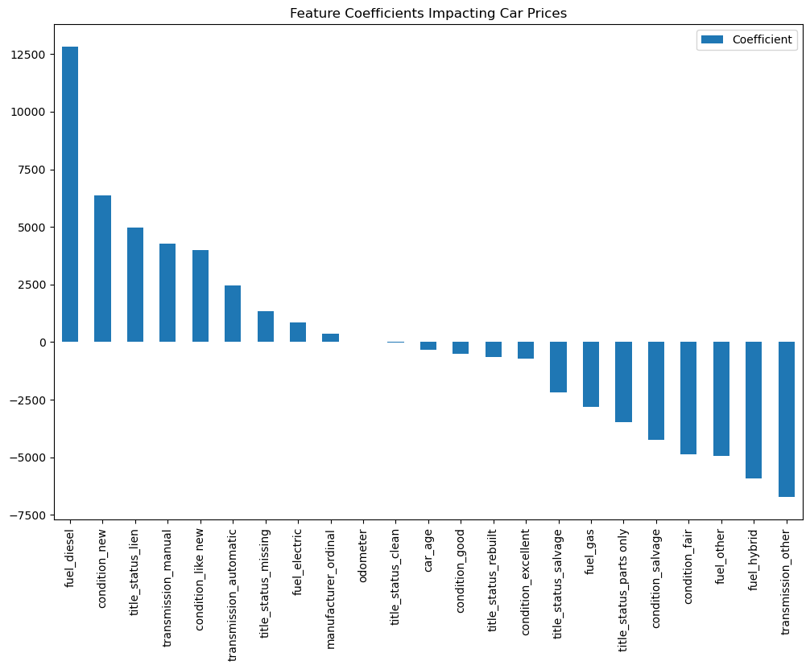
Model 2
Used additional characteristics like Car Condition, Fuel, Transmission, and Title Status to build the model
The Fuel Diesel, Car Condition, The Title Status and Transmission have bigger influence on the price
In this model the manufacturer influence has average influence on the price of the car

Slide 7
Model 2 - Continuation
Factors Influencing the price
Fuel diesel 12813.54
Fuel electric 864.91
Fuel gas -2809.21
Fuel hybrid -5923.04
Fuel other -4946.19
Transmission automatic 2466.50
Transmission manual 4262.94
Transmission other -6729.44
Title status clean -31.99
Title status lien 4978.08
Title status missing 1346.73
Title status parts only -3463.51
Title status rebuilt -658.28
Title status salvage -2171.02
Factors Influencing the price
Manufacturer 350.82
Age -348.05
odometer -0.02
Condition excellent -728.96
Condition fair -4877.72
Condition good -491.05
Condition like new 3984.49
Condition new 6364.61
Condition salvage -4251.35

Slide 8
Model 1 Evaluation
MSE & RMSE: These values are quite high, suggesting that the model’s predictions deviate significantly from the actual values. RMSE gives a sense of the average error magnitude in the same units as the target variable (price), which here is quite substantial.
MAE: This value also confirms that on average, the model errors by about $8,496.71, which is a considerable error given the context of car pricing.
R² & Adjusted R²: An R² of 0.15 indicates that only 15% of the variance in the car prices is being explained by the model. This is quite low, suggesting that the model is not capturing much of the variability in car prices.
Mean Squared Error (MSE): 158839085.37
Root Mean Squared Error (RMSE): 12603.13
Mean Absolute Error (MAE): 8496.71
R-squared (R²): 0.15
Adjusted R-squared: 0.15

Slide 9
Model 2 Evaluation
MSE & RMSE: These values are quite high, suggesting that the model’s predictions deviate significantly from the actual values. RMSE gives a sense of the average error magnitude in the same units as the target variable (price), which here is quite substantial.
MAE: This value also confirms that on average, the model errors by about $7,780.21, which is a considerable error given the context of car pricing.
R² & Adjusted R²: An R² of 0.26 indicates that only 26% of the variance in the car prices is being explained by the model. This is quite low, suggesting that the model is not capturing much of the variability in car prices.
Mean Squared Error (MSE): 139326249.78
Root Mean Squared Error (RMSE): 11803.65
Mean Absolute Error (MAE): 7780.21
R-squared (R²): 0.26
Adjusted R-squared: 0.25

Slide 10
Deployment
Model 2 is a better model, because it is built based upon more characteristics
(Age, Odometer, Manufacturer, Fuel, Condition, Title and Transmission)
With the test data, the model error is by about $7,780.21, which is a considerable error given the context of car pricing. (This may be due to limited data)
R² & Adjusted R²: An R² of 0.25 indicates that only 25% of the variance in the car prices is being explained by the model. This is quite low, suggesting that the model is not capturing much of the variability in car prices.
Characteristics | Comment
Manufacturer , Condition new, Fuel diesel, Transmission automatic , Title status lien | All have positive influence
Age, Condition fair, Fuel other, Title status salvage, Transmission other | All have negative influence
odometer , Fuel electric | Have limited impact on the car

